Slide 1
Artificial Neural Networks
Images and notes were retrieved from Aurélien Géron - Hands-on Machine Learning with Scikit-Learn and TensorFlow (2017/2019, O’Reilly)

Slide 2
From Biological to Artificial Neurons
The first artificial neural network architecture proposed by McCulloch and Pitts in 1943 using propositional logic (paper).
Until 60s, there was a belief for truly intelligent machines. However ANNs entered a long dark era in 60s.
Better training techniques were developed in 80s, again became popular.
SVMs started to outperform ANNs by the 90s.
Now yet another wave of interest in ANNs with 2010s, but this time is a bit different.
Huge amount of data and increase in computing power.
Improved algorithms. Even small tweaks have a huge positive impact.
Some theoretical limitations → but not in practice. They were likely to get stuck in local optima, but it turns out that this is rather rare in practice.

Slide 3
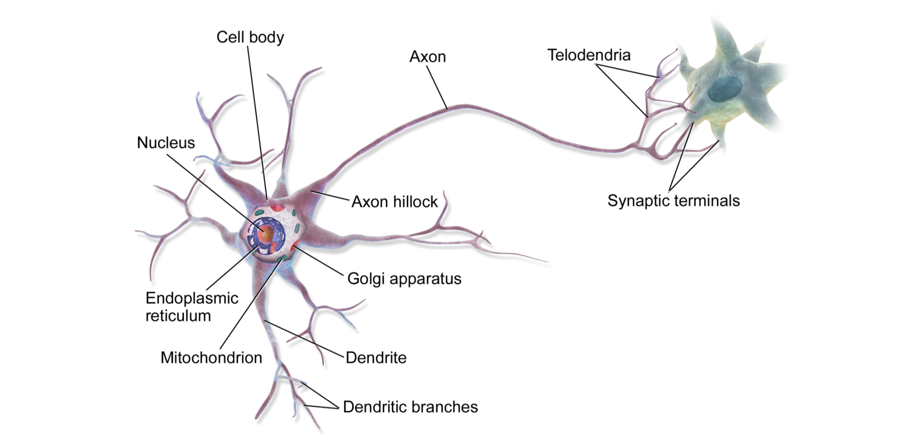
Biological Neurons

Slide 4
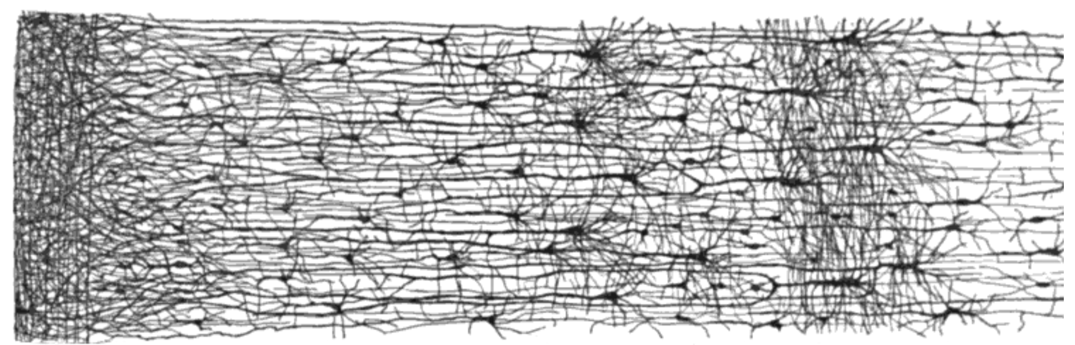
Biological Neural Network (Multiple Layers)

Slide 5
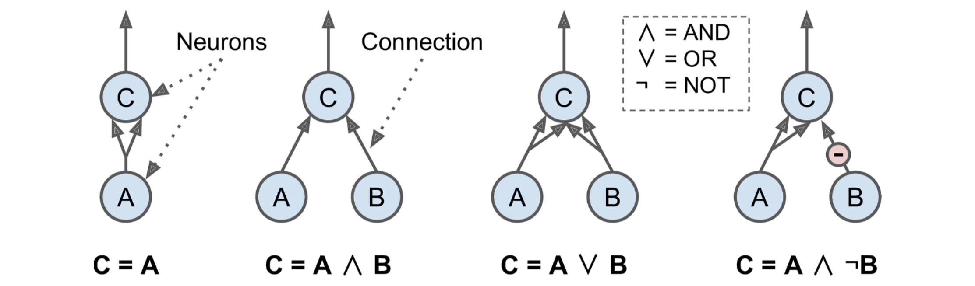
Artificial Neuron
McCulloch and Pitts proposed a very simple model of biological neuron (an artificial neuron).
Has one or more binary (on/off) inputs and one binary output.
It is possible to build a network of artificial neurons that computes any logical proposition.
Let’s assume that a neuron is activated when at least two of its inputs are active

Slide 6
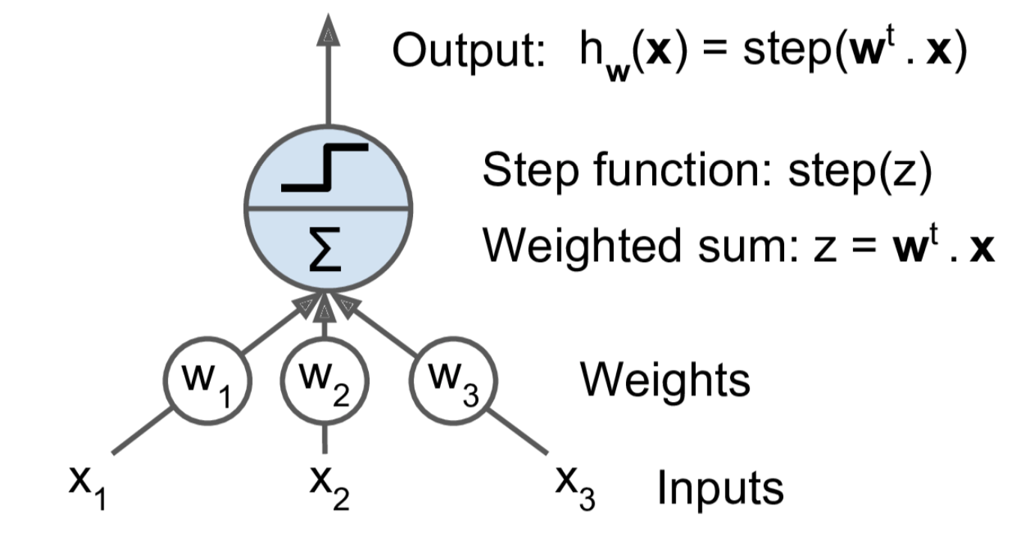
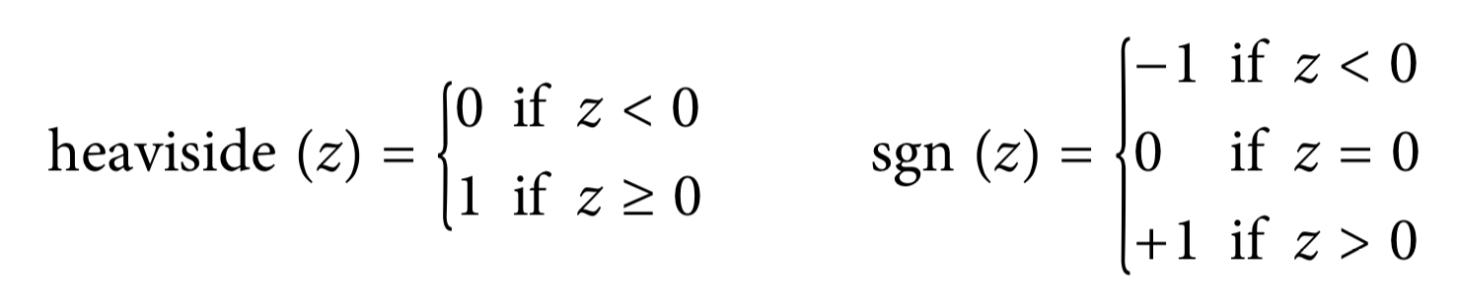
Linear Threshold Unit (LTU)
Slightly different AN, Inputs and outputs are numbers →
The most common step function used in Perceptrons is the Heaviside step function.

Slide 7
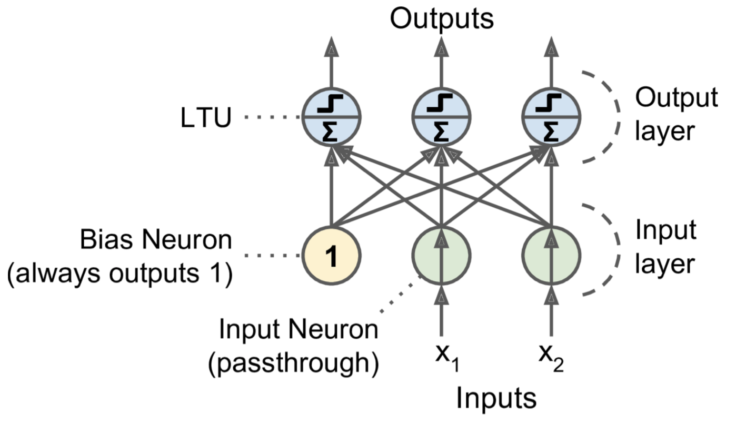
Perceptron
A Perceptron is simply composed of a single layer of LTUs, with each neuron connected to all the inputs.
Input neurons → they just output whatever input they are fed.
Extra bias feature is added as well (x0 = 1).
A Perceptron with two inputs and three outputs →

Slide 8
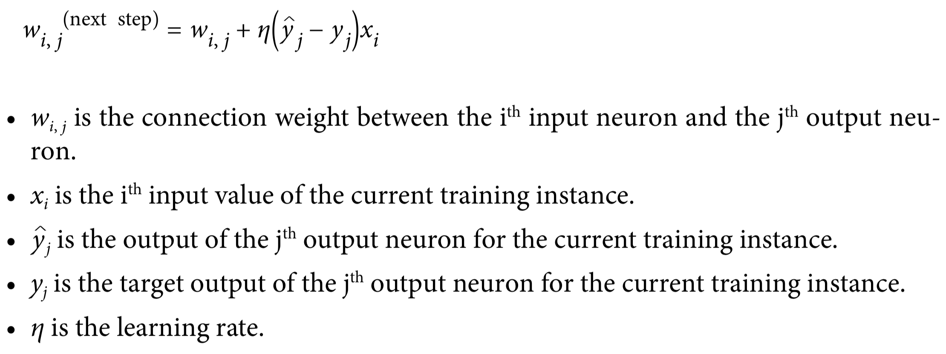
How to Train Perceptron
Hebb’s rule → “Cells that fire together, wire together.”
connection weight between two neurons is increased whenever they have the same output.

Slide 9
Perceptron
The decision boundary of each output neuron is linear.
Perceptron class in sklearn.
Perceptron() = SGDClassifier(loss="perceptron", learning_rate="constant", eta0=1, penalty=None)

Slide 10
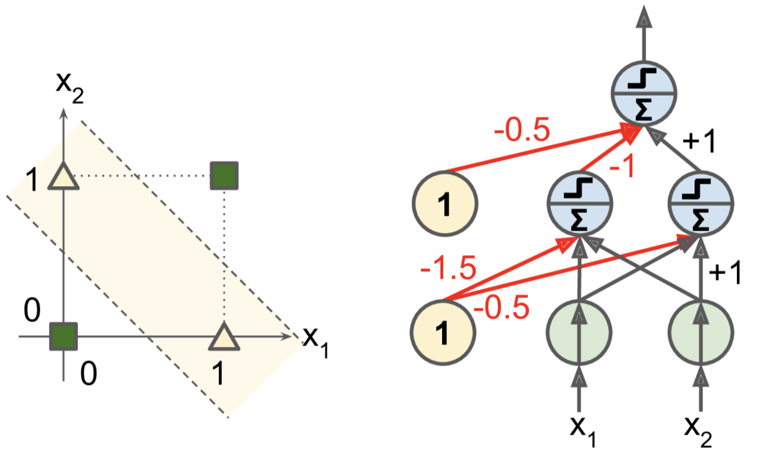
Multi-Layer Perceptron (MLP)
In 1969, Minsky and Papert showed a number of serious weaknesses of Perceptrons.
For instance, XOR problem cannot be solved (like Logistic Regression)
The limitations of Perceptrons can be eliminated by Multi-Layer Perceptron.

Slide 11
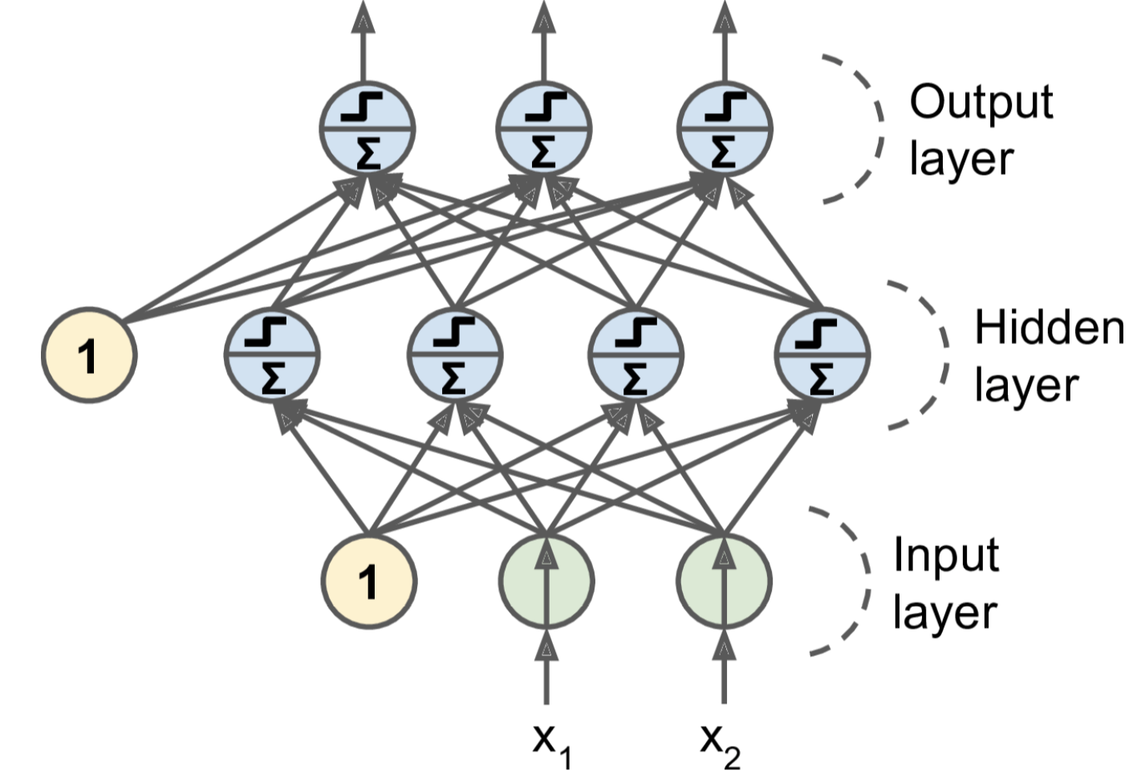
Multi-Layer Perceptron (MLP)

Slide 12
Deep Neural Networks (DNN)
When an ANN contains a deep stack of hidden layers, it is called a deep neural network (DNN).
In the 1990s, an ANN with more than two hidden layers was considered deep.
Nowadays, it is common to see ANNs with dozens of layers, or even hundreds
Therefore, the definition of “deep” is quite fuzzy.

Slide 13
Backpropagation Algorithm
For each training instance the backpropagation algorithm first makes a prediction → Forward Pass
Measures the error, then goes through each layer in reverse to measure the error contribution from each connection → Reverse Pass
Finally slightly tweaks the connection weights to reduce the error → Gradient Descent step Original Paper: Rumelhart et al. (Link)

Slide 14
Backpropagation Algorithm (Detailed Steps)
It handles one mini-batch at a time (for example, containing 32 instances each), and it goes through the full training set multiple times. Each pass is called an epoch.
Each mini-batch is passed to the network’s input layer, which sends it to the first hidden layer. The algorithm then computes the output of all the neurons in this layer (for every instance in the mini-batch). The result is passed on to the next layer, its output is computed and passed to the next layer, and so on until we get the output of the last layer, the output layer. This is the forward pass: it is exactly like making predictions, except all intermediate results are preserved since they are needed for the backward pass.

Slide 15
Backpropagation Algorithm (Detailed Steps)
Next, the algorithm measures the network’s output error (i.e., it uses a loss function that compares the desired output and the actual output of the network, and returns some measure of the error).
Then it computes how much each output connection contributed to the error. This is done analytically by applying the chain rule (perhaps the most fundamental rule in calculus), which makes this step fast and precise.

Slide 16
Backpropagation Algorithm (Detailed Steps)
The algorithm then measures how much of these error contributions came from each connection in the layer below, again using the chain rule, working backward until the algorithm reaches the input layer. As explained earlier, this reverse pass efficiently measures the error gradient across all the connection weights in the network by propagating the error gradient backward through the network (hence the name of the algorithm).
Finally, the algorithm performs a Gradient Descent step to tweak all the connection weights in the network, using the error gradients it just computed.

Slide 17
Warning
It is important to initialize all the hidden layers’ connection weights randomly, or else training will fail.
For example, if you initialize all weights and biases to zero, then all neurons in a given layer will be perfectly identical, and thus backpropagation will affect them in exactly the same way, so they will remain identical.
In other words, despite having hundreds of neurons per layer, your model will act as if it had only one neuron per layer: it won’t be too smart.
If instead you randomly initialize the weights, you break the symmetry and allow backpropagation to train a diverse team of neurons.

Slide 18
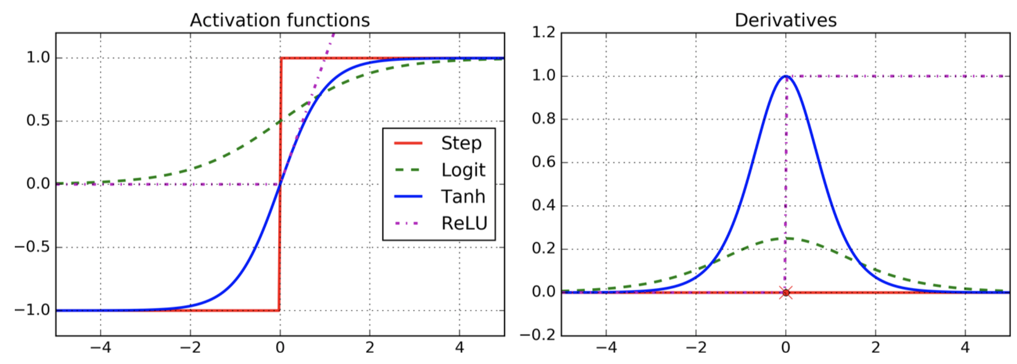
Activation Functions
Authors in Backpropagation paper replaced the step function with the logistic (sigmoid) function, σ(z) = 1 / (1 + exp(-z)); because step function just contains flats. Gradient Descent cannot work on it.
The hyperbolic tangent function, tanh(z) = 2σ(2z) – 1
The ReLU function, ReLU(z) = max (0, z)

Slide 19
Why Do We Need Activation Functions?
If you chain several linear transformations, all you get is a linear transformation. For example, if f(x) = 2x + 3 and g(x) = 5x – 1, then chaining these two linear functions gives you another linear function: f(g(x)) = 2(5x – 1) + 3 = 10x + 1.
So if you don’t have some nonlinearity between layers, then even a deep stack of layers is equivalent to a single layer, and you can’t solve very complex problems.
Conversely, a large enough DNN with nonlinear activations can theoretically approximate any continuous function.

Slide 20
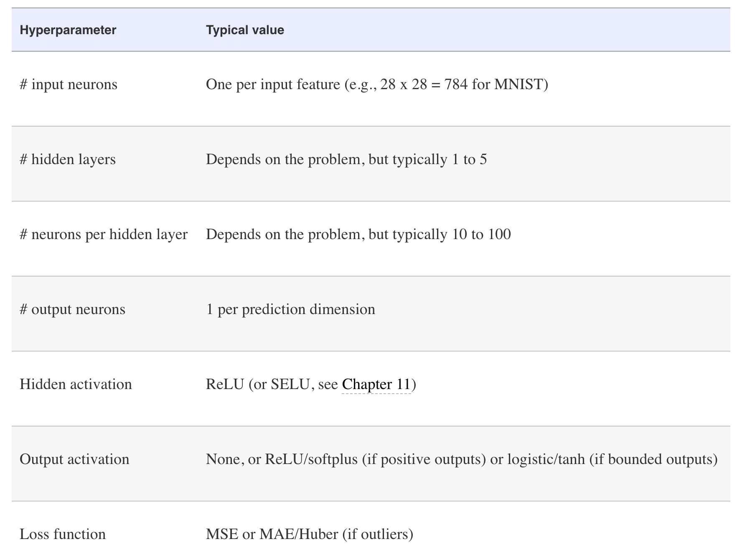
Regression MLPs

Slide 21
Regression MLPs
The Huber loss is quadratic when the error is smaller than a threshold δ (typically 1) but linear when the error is larger than δ.
The linear part makes it less sensitive to outliers than the mean squared error, and the quadratic part allows it to converge faster and be more precise than the mean absolute error.

Slide 22
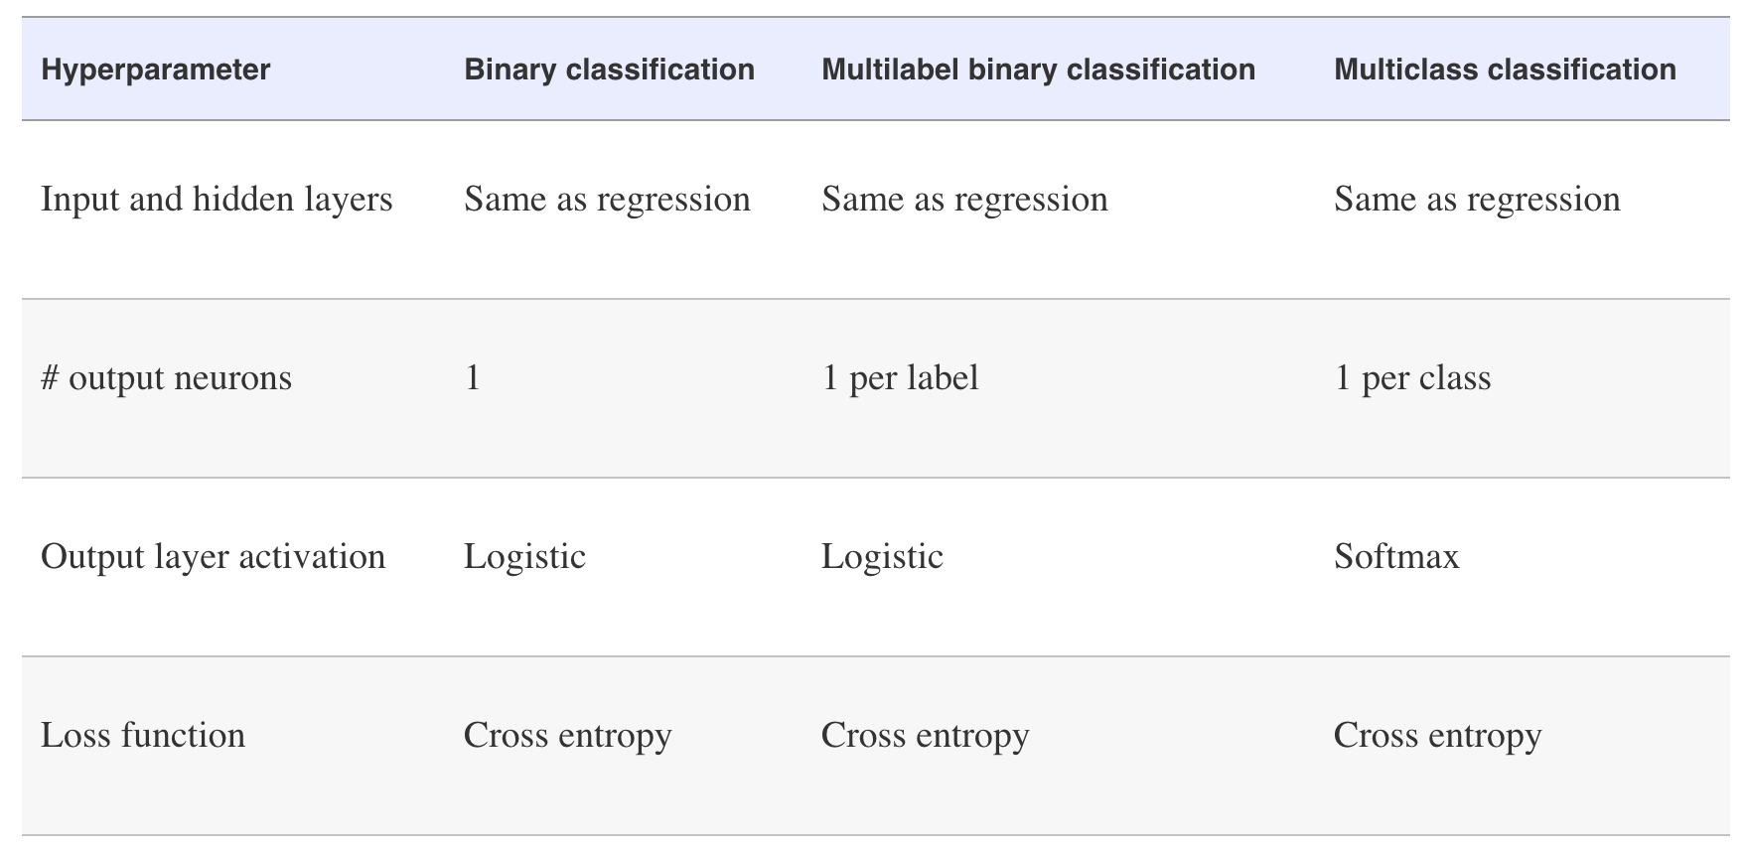
Classification MLPs

Slide 23
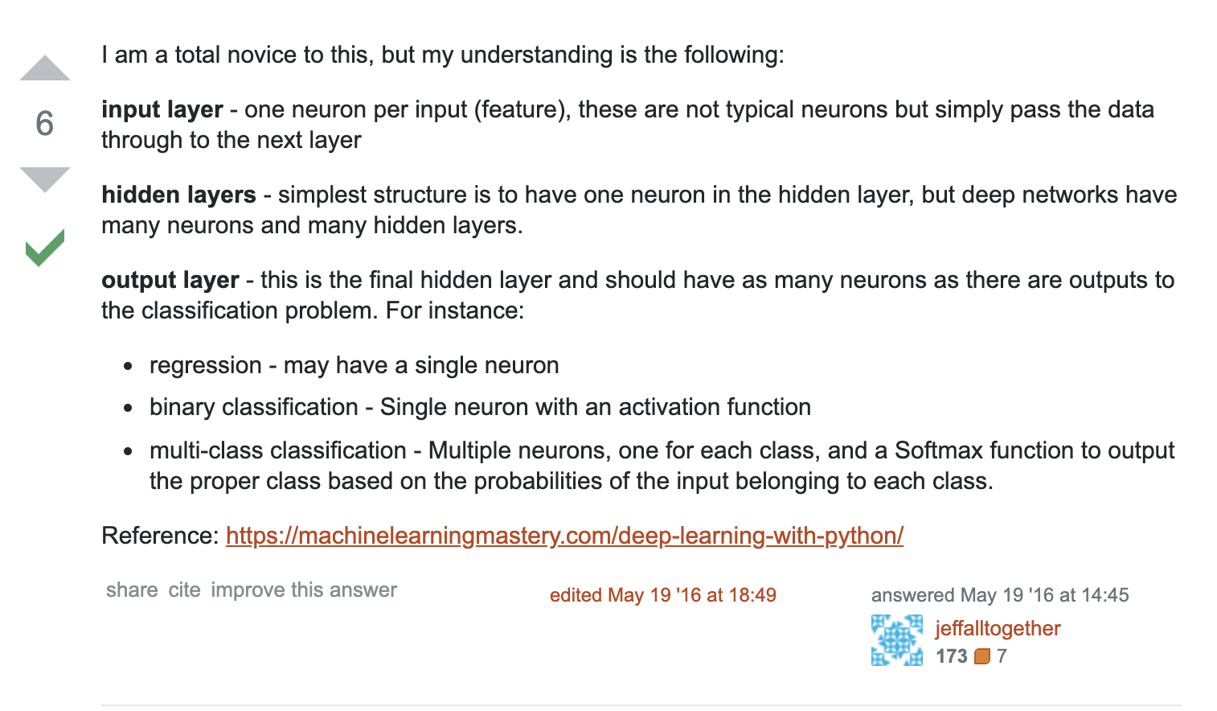
The Number of Neurons in Output Layer
Source: https://stats.stackexchange.com/a/213482

Slide 24
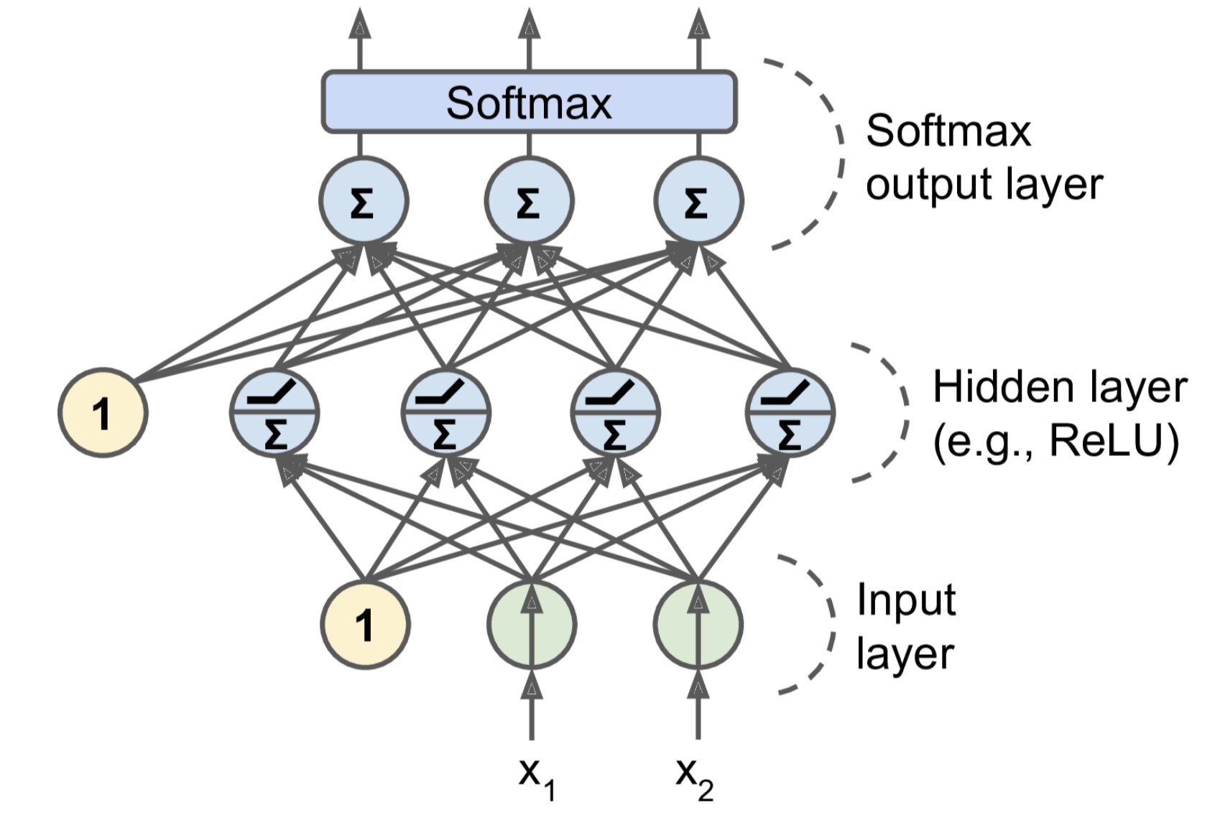
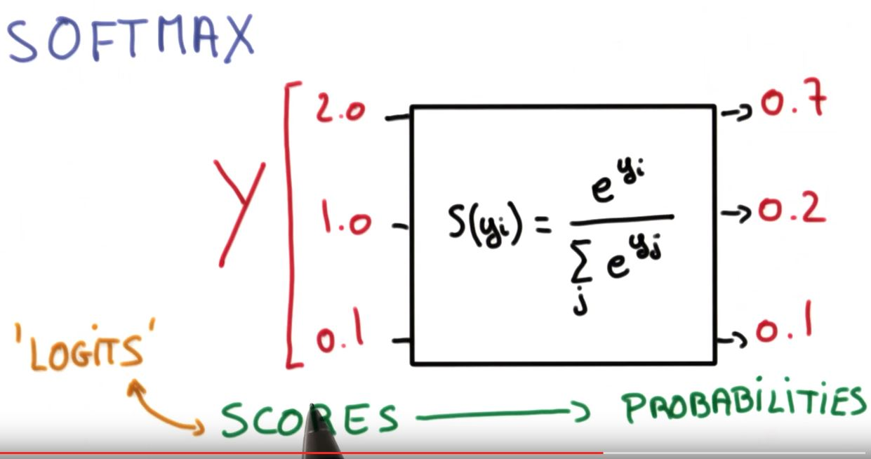
Softmax Function
An MLP is often used for binary classification.
When we have more than 2 classes, the output layer is typically modified by replacing the individual activation functions by a shared softmax function.

Slide 25
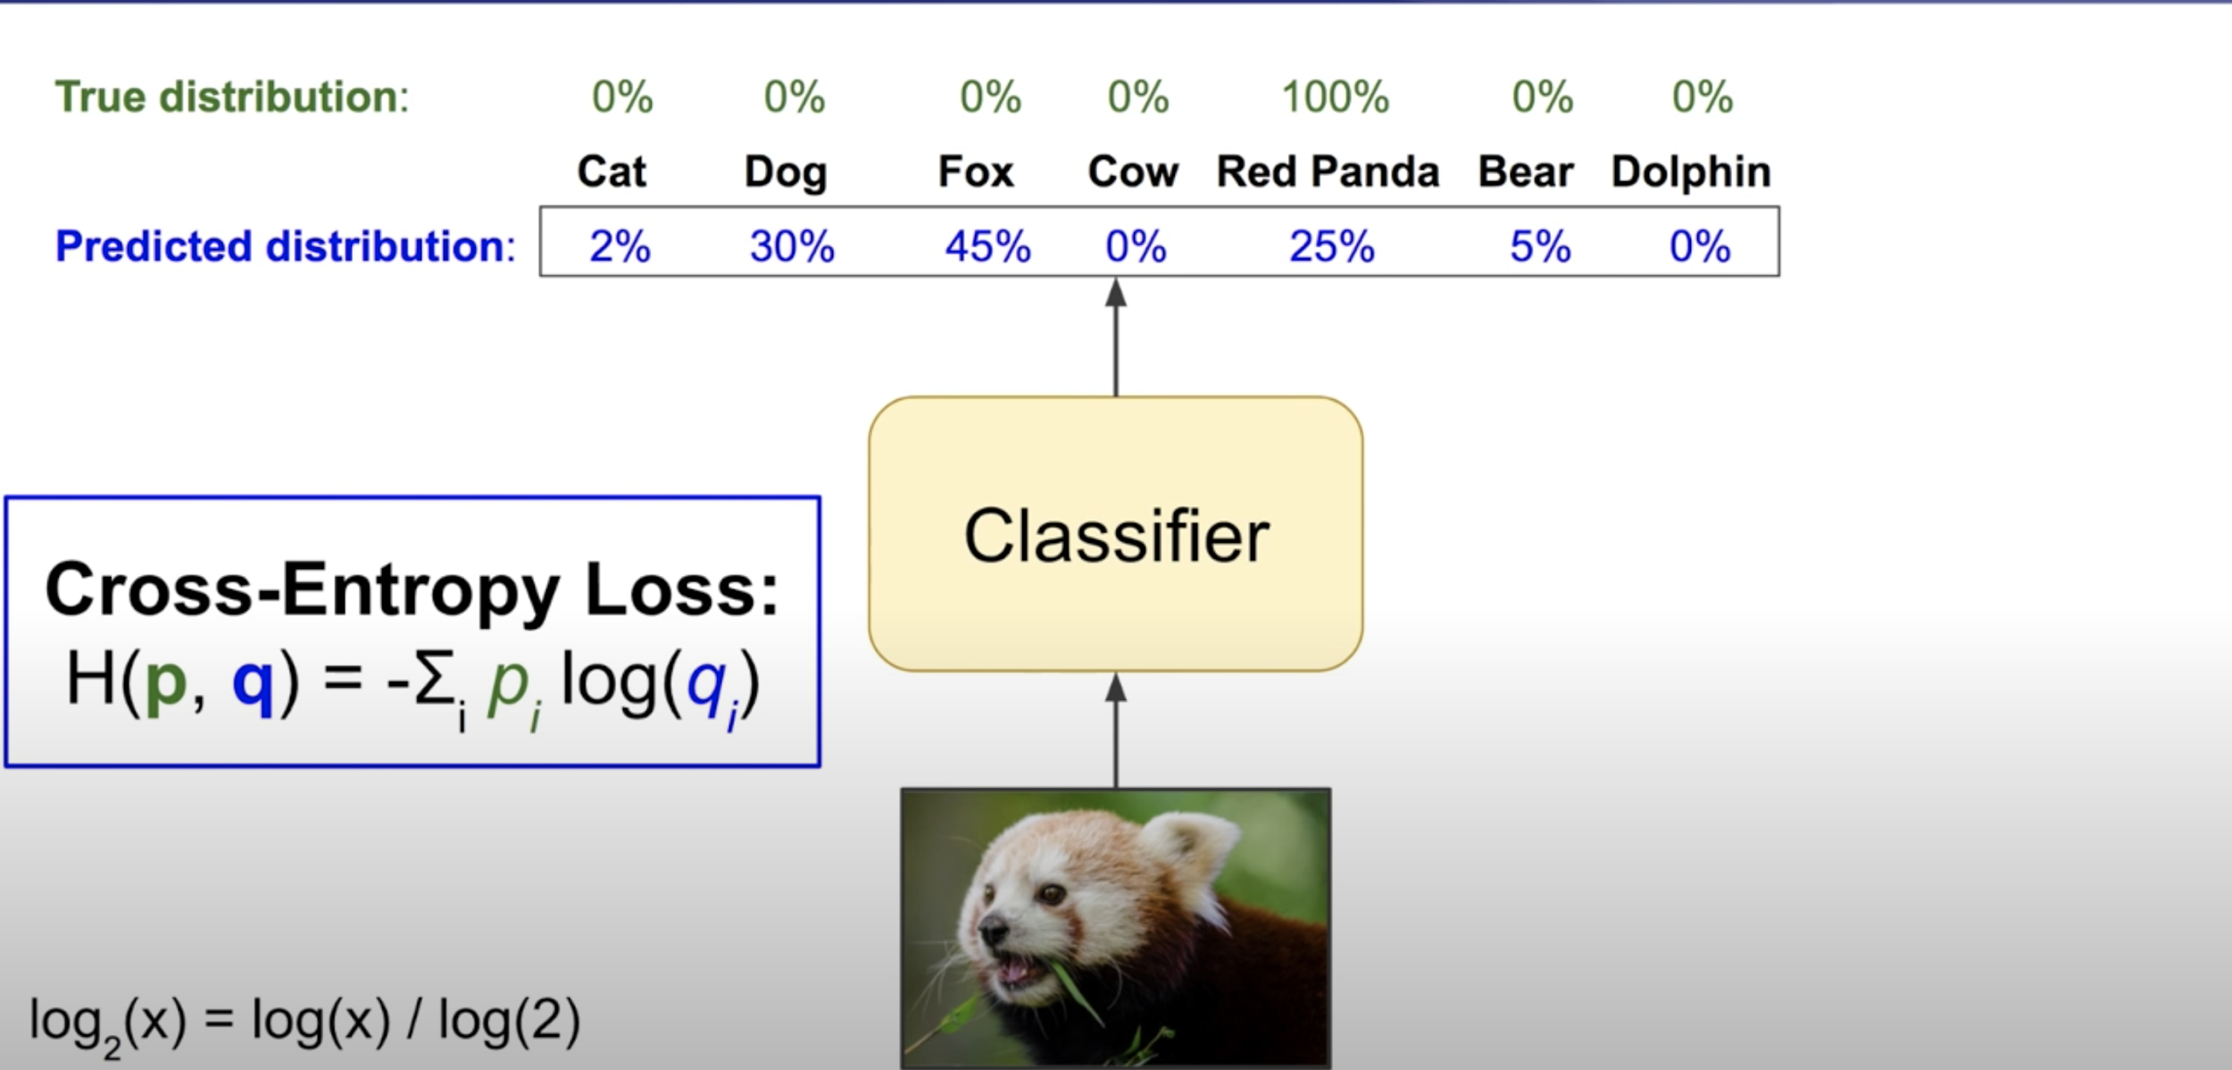
Cross Entropy Loss (Log loss) Source

Slide 26
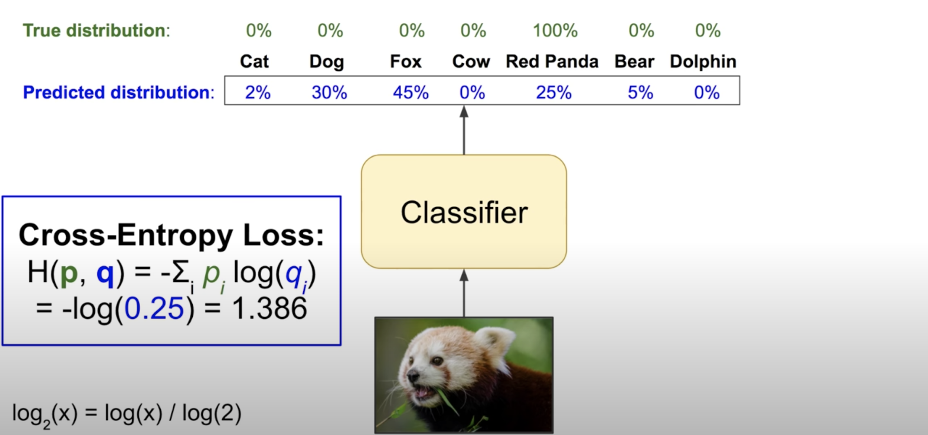
Cross Entropy Loss (Log loss) Source

Slide 27
Implementing MLPs with Keras
Keras is a high-level Deep Learning API developed by Francois Chollet(https://keras.io/)
You can use Keras on three popular open source Deep Learning libraries:
TensorFlow
Microsoft Cognitive Toolkit (CNTK)
Theano
TensorFlow itself now comes bundled with its own Keras implementation, tf.keras.
It only supports TensorFlow as the backend
But it has the advantage of offering some very useful extra features like TensorFlow’s Data API

Slide 28
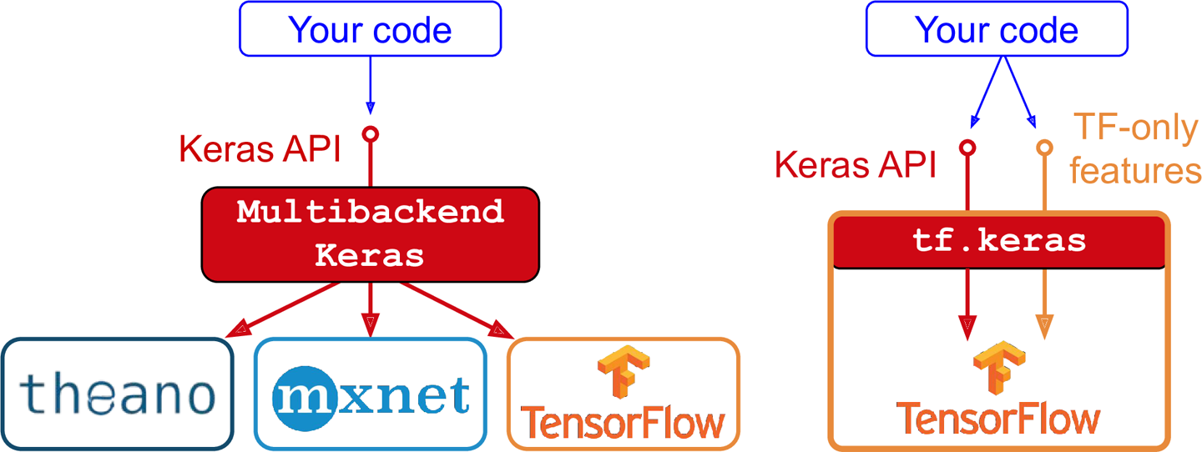
Implementing MLPs with Keras

Slide 29
Fashion MNIST Dataset
fashion_mnist = keras.datasets.fashion_mnist
(X_train_full, y_train_full), (X_test, y_test) = fashion_mnist.load_data()
class_names = ["T-shirt/top", "Trouser", "Pullover", "Dress", "Coat","Sandal", "Shirt", "Sneaker", "Bag", "Ankle boot"]

Slide 30

Fashion MNIST

Slide 31
Sequential API - Composing Model
model = keras.models.Sequential()
model.add(keras.layers.Flatten(input_shape=[28, 28]))
model.add(keras.layers.Dense(300, activation="relu"))
model.add(keras.layers.Dense(100, activation="relu"))
model.add(keras.layers.Dense(10, activation="softmax"))

Slide 32
Sequential API - Composing Model
or model = keras.models.Sequential([
keras.layers.Flatten(input_shape=[28, 28]),
keras.layers.Dense(300, activation="relu"),
keras.layers.Dense(300, activation="relu"),
keras.layers.Dense(10, activation="softmax")
])
Instead of activation="relu", activation=keras.activations.relu could also be used.

Slide 33
Sequential API - Model Summary
model.summary() Model: "sequential_4"
_________________________________________________________________
Layer (type) Output Shape Param #
=================================================================
flatten_2 (Flatten) (None, 784) 0
_________________________________________________________________
dense_9 (Dense) (None, 300) 235500
_________________________________________________________________
dense_10 (Dense) (None, 300) 90300
_________________________________________________________________
dense_11 (Dense) (None, 10) 3010
=================================================================
Total params: 328,810
Trainable params: 328,810
Non-trainable params: 0

Slide 34
Sequential API - Accessing Layers
model.layers [<tensorflow.python.keras.layers.core.Flatten at 0x7fd0ecfb57f0>,
<tensorflow.python.keras.layers.core.Dense at 0x7fd0e74c9860>,
<tensorflow.python.keras.layers.core.Dense at 0x7fd0ecf9afd0>,
<tensorflow.python.keras.layers.core.Dense at 0x7fd0e74da2e8>] model.layers[1].name
'dense_9'
model.get_layer("dense_9") <tensorflow.python.keras.layers.core.Dense at 0x7fd0e74c9860>

Slide 35
Sequential API - Accessing Weights and Biases
weights, biases = model.layers[1].get_weights() weights
'dense_9'
model.get_layer("dense_9") <tensorflow.python.keras.layers.core.Dense at 0x7fd0e74c9860>

Slide 36
Sequential API - Initializers
Notice that the Dense layer initialized the connection weights randomly and the biases were initialized to zeros, which is fine.
If you ever want to use a different initialization method, you can set kernel_initializer (kernel is another name for the matrix of connection weights) or bias_initializer when creating the layer.
For the full list, see https://keras.io/initializers/.

Slide 37
Sequential API - Probobalistic Losses
BinaryCrossentropy
It can be used when there are only 2 classes (0 and 1)
y_true = [[0, 1], [1, 0]]
y_pred = [[0, 1], [0.52, 0.48]]
m = keras.losses.BinaryCrossentropy()
m(y_true, y_pred).numpy()

Slide 38
Sequential API - Probobalistic Losses
CategoricalCrossentropy
To be used when there are multiple label classes (2 or more). Here we assume that labels are given as a one_hot representation. eg., When labels values are [2, 0, 1], y_true = [[0, 0, 1], [1, 0, 0], [0, 1, 0]].
y_true = [[1, 0, 0], [1, 0, 0]]
y_pred = [[1, 0, 0], [0.52, 0.47, 0.01]]
m = keras.losses.CategoricalCrossentropy()
m(y_true, y_pred).numpy()

Slide 39
Sequential API - Probobalistic Losses
SparseCategoricalCrossentropy
To be used when there are two or more label classes. We expect labels to be provided as integers. If you want to provide labels using one-hot representation, please use CategoricalCrossentropy metric.
y_true = [0, 2, 1]
y_pred = [[1, 0, 0], [0.52, 0.47, 0.01], [0.1, 0.2, 0.7]]
m = keras.metrics.SparseCategoricalCrossentropy()
np.set_printoptions(suppress=True)
m(y_true, y_pred).numpy() For more information, visit https://keras.io/api/losses/ and https://keras.io/api/losses/probabilistic_losses/

Slide 40
Sequential API - Probobalistic Losses
If you want to convert sparse labels (i.e., class indices) to one-hot vector labels, use the keras.utils.to_categorical() function. keras.utils.to_categorical([0, 2, 1]) returns array([[1., 0., 0.],
[0., 0., 1.],
[0., 1., 0.]], dtype=float32)

Slide 41
Sequential API - Compiling Model
model.compile(optimizer=keras.optimizers.SGD(),
loss=keras.losses.sparse_categorical_crossentropy,
metrics=keras.metrics.sparse_categorical_accuracy)
or
model.compile(optimizer="sgd",
loss="sparse_categorical_crossentropy",
metrics="sparse_categorical_accuracy")

Slide 42
Sequential API - Training Model
history = model.fit(X_train, y_train, validation_data=(X_val, y_val), epochs=20) Extra features that can be used:
validation_split → instead of passing a validation set using the validation_data argument, you could set validation_split to the ratio of the training set that you want Keras to use for validation.
class_weight → to give a larger weight to underrepresented classes and a lower weight to overrepresented classes.
sample_weight → per-instance weights

Slide 43
Sequential API - Training Model
fit method returns an object called history. It has 3 attributes:
params
epoch
history → returns a dictionary which can be converted into a pandas DataFrame. This dataframe can be plotted.

Slide 44
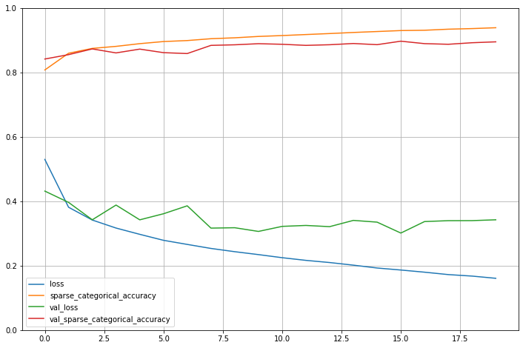
Sequential API - Training Model

Slide 45
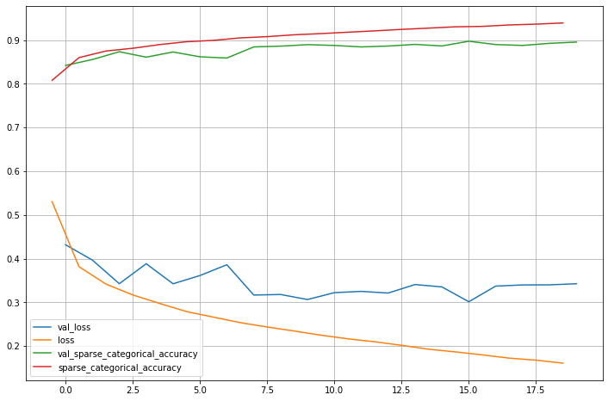
Sequential API - Training Model
When plotting the training curve, it should be shifted by half an epoch to the left.

Slide 46
Sequential API - Evaluating Model
model.evaluate(X_test, y_test) 313/313 [==============================] - 1s 2ms/step - loss: 65.6149 - sparse_categorical_accuracy: 0.8524
[65.61493682861328, 0.852400004863739]
You can also provide batch_size and sample_weight parameters as well.

Slide 47
Sequential API - Making Predictions
model.predict(X_test[:2]) array([[0., 0., 0., 0., 0., 0., 0., 0., 0., 1.],
[0., 0., 1., 0., 0., 0., 0., 0., 0., 0.]], dtype=float32)
predict method returns the class probabilities. model.predict_classes(X_test[:2]) array([9, 2]) predict_classes method returns the class with the highest probability.

Slide 48
Sequential API - Making Predictions
Here is another evaluation method: preds = model.predict(X_test)
y_test_hot = keras.utils.to_categorical(y_test)
keras.metrics.categorical_accuracy(y_test_hot, preds).numpy().mean()

Slide 49
Sequential API - Regression Problem
The main differences:
the output layer has a single neuron (since we only want to predict a single value)
the output layer uses no activation function
the loss function is the mean squared error.
Tip: If you get NaN values during training, the your model might be too complex (reduce complexity) or the learning rate might be too high.

Slide 50
Sequential API - Regression Problems
First, download and prepare the dataset. housing = fetch_california_housing()
X_train_full, X_test, y_train_full, y_test = train_test_split(housing.data, housing.target)
X_train, X_valid, y_train, y_valid = train_test_split(
X_train_full, y_train_full)
scaler = StandardScaler()
X_train = scaler.fit_transform(X_train)
X_valid = scaler.transform(X_valid)
X_test = scaler.transform(X_test)

Slide 51
Sequential API - Regression Problems
First, download and prepare the dataset. reg_model = keras.models.Sequential()
reg_model.add(keras.layers.Dense(100, activation="relu",input_shape=X_train.shape[1:]))
reg_model.add(keras.layers.Dense(50, activation="relu"))
reg_model.add(keras.layers.Dense(1)) reg_model.compile(optimizer=keras.optimizers.SGD(learning_rate=0.001), loss="mse") history = reg_model.fit(X_train, y_train, validation_data=(X_valid, y_valid), epochs=10)

Slide 52
Functional API
input_ = keras.layers.Input(shape=X_train.shape[1:])
dense1 = keras.layers.Dense(100, activation="relu")(input_)
dense2 = keras.layers.Dense(50, activation="relu")(dense1)
output = keras.layers.Dense(1)(dense2)
model = keras.Model(inputs=[input_], outputs=[output])
model.compile(optimizer=keras.optimizers.SGD(learning_rate=0.001), loss="mse")
history = model.fit(X_train, y_train, validation_data=(X_valid, y_valid), epochs=10)

Slide 53
Functional API - Wide and Deep Neural Network
Wide and Deep Neural Networks for Recommender Systems by Heng-Tze Cheng et al. 2016
This architecture makes it possible for the neural network to learn both
deep patterns (using the deep path)
and simple rules (through the short path)

Slide 54
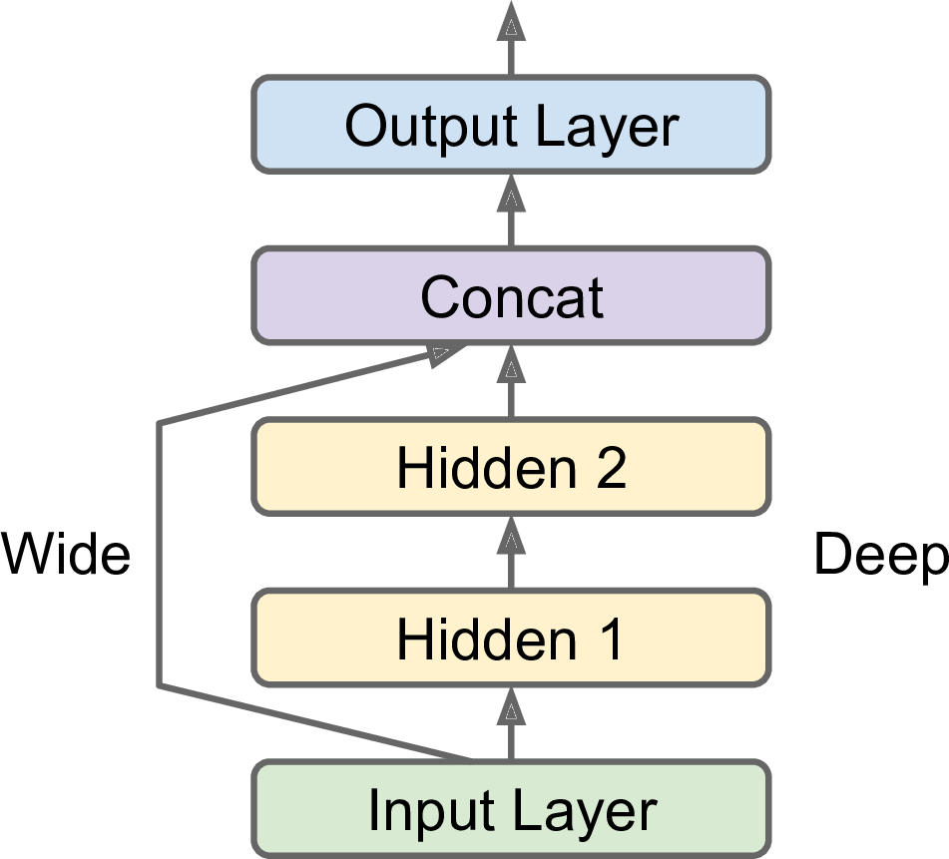
Functional API - Wide and Deep Neural Network - Scenario 1

Slide 55
Functional API - Wide and Deep Neural Network - Scenario 1
input_ = keras.layers.Input(shape=X_train.shape[1:])
dense1 = keras.layers.Dense(100, activation="relu")(input_)
dense2 = keras.layers.Dense(50, activation="relu")(dense1)
concat = keras.layers.Concatenate()([input_, dense2])
output = keras.layers.Dense(1)(concat)
model = keras.Model(inputs=[input_], outputs=[output])
model.compile(optimizer=keras.optimizers.SGD(learning_rate=0.001), loss="mse")
history = model.fit(X_train, y_train, validation_data=(X_valid, y_valid), epochs=10)

Slide 56
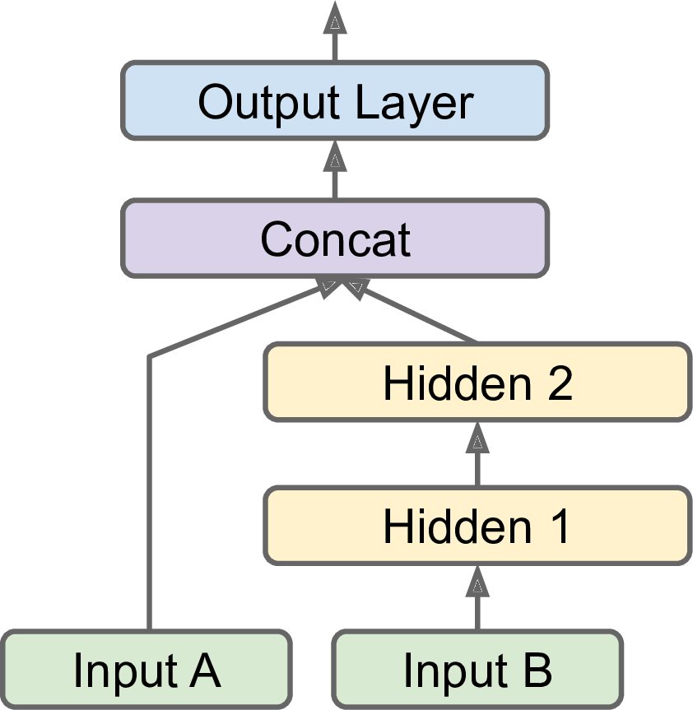
Functional API - Wide and Deep Neural Network - Scenario 2

Slide 57
Functional API - Wide and Deep Neural Network - Scenario 2
X_trainA = X_train[:,:5]
X_trainB = X_train[:,2:]
X_validA = X_valid[:,:5]
X_validB = X_valid[:,2:]
X_testA = X_test[:,:5]
X_testB = X_test[:,2:]

Slide 58
Functional API - Wide and Deep Neural Network - Scenario 2
inputA = keras.layers.Input(shape=[5])
inputB = keras.layers.Input(shape=[6])
dense1 = keras.layers.Dense(100, activation="relu")(inputB)
dense2 = keras.layers.Dense(50, activation="relu")(dense1)
concat = keras.layers.Concatenate()([inputA, dense2])
output = keras.layers.Dense(1)(concat)
model = keras.Model(inputs=[inputA, inputB], outputs=[output])
model.compile(optimizer=keras.optimizers.SGD(learning_rate=0.001), loss="mse")
history = model.fit((X_trainA, X_trainB), y_train, epochs=10, validation_data=((X_validA, X_validB), y_valid)) model.evaluate((X_testA, X_testB), y_test)

Slide 59
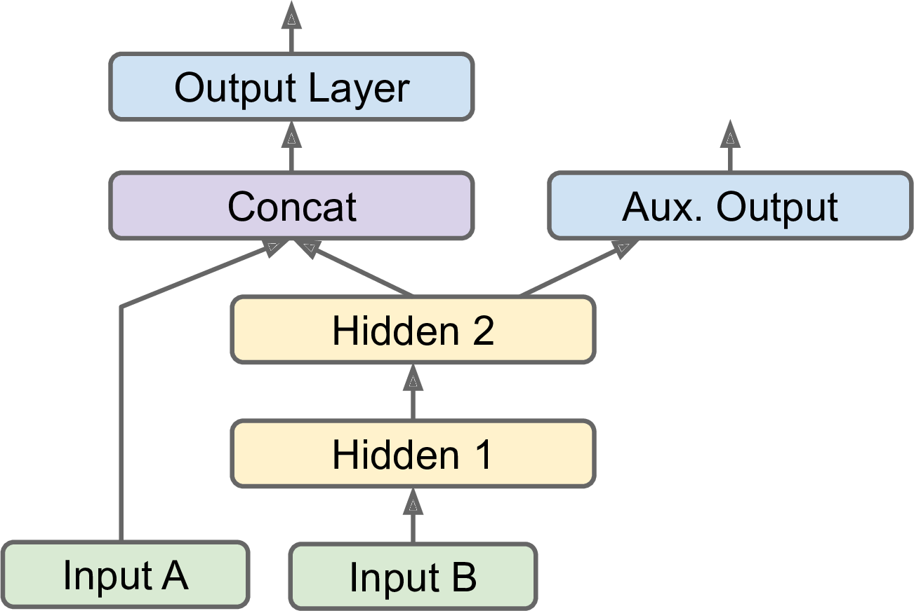
Functional API - Wide and Deep Neural Network - Scenario 3

Slide 60
Functional API - Wide and Deep Neural Network - Scenario 3
Why do we need auxiliary output?
The task may demand it. For instance, you may want to locate and classify the main object in a picture. This is both a regression task (finding the coordinates of the object’s center, as well as its width and height) and a classification task.
Similarly, you may have multiple independent tasks based on the same data.
Sure, you could train one neural network per task, but in many cases you will get better results on all tasks by training a single neural network with one output per task.
This is because the neural network can learn features in the data that are useful across tasks. For example, you could perform multitask classification on pictures of faces, using one output to classify the person’s facial expression (smiling, surprised, etc.) and another output to identify whether they are wearing glasses or not.

Slide 61
Functional API - Wide and Deep Neural Network - Scenario 3
Why do we need auxiliary output?
Another use case is as a regularization technique (i.e., a training constraint whose objective is to reduce overfitting and thus improve the model’s ability to generalize).
For example, you may want to add some auxiliary outputs in a neural network architecture to ensure that the underlying part of the network learns something useful on its own, without relying on the rest of the network.

Slide 62
Functional API - Wide and Deep Neural Network - Scenario 3
inputA = keras.layers.Input(shape=X_trainA.shape[1:])
inputB = keras.layers.Input(shape=X_trainB.shape[1:])
dense1 = keras.layers.Dense(100, activation="relu")(inputB)
dense2 = keras.layers.Dense(50, activation="relu")(dense1)
concat = keras.layers.Concatenate()([inputA, dense2])
output1 = keras.layers.Dense(1)(concat)
output2_aux = keras.layers.Dense(1)(dense2)
model = keras.Model(inputs=[inputA, inputB], outputs=[output1, output2_aux])
model.compile(optimizer=keras.optimizers.SGD(learning_rate=0.001), loss="mse")
history = model.fit((X_trainA, X_trainB), (y_train, y_train), epochs=10, validation_data=((X_validA, X_validB), (y_valid, y_valid))) Be careful while providing the data

Slide 63
Functional API - Wide and Deep Neural Network - Scenario 3
inputA = keras.layers.Input(shape=X_trainA.shape[1:])
inputB = keras.layers.Input(shape=X_trainB.shape[1:])
dense1 = keras.layers.Dense(100, activation="relu")(inputB)
dense2 = keras.layers.Dense(50, activation="relu")(dense1)
concat = keras.layers.Concatenate()([inputA, dense2])
output1 = keras.layers.Dense(1, name="main_output")(concat)
output2_aux = keras.layers.Dense(1, name="aux_output")(dense2)
model = keras.Model(inputs=[inputA, inputB], outputs=[output1, output2_aux])
model.compile(optimizer=keras.optimizers.SGD(learning_rate=0.001), loss="mse", loss_weights=[0.9, 0.1])
history = model.fit((X_trainA, X_trainB), (y_train, y_train), epochs=10, validation_data=((X_validA, X_validB), (y_valid, y_valid))) You can also give names to the layers and change weight of each output

Slide 64
Functional API - Wide and Deep Neural Network - Scenario 3
Total_loss, main_loss, aux_loss = model.evaluate(x=(X_testA, X_testB), y=(y_test, y_test)) This the way to evaluate your model with test data

Slide 65
Functional API - Wide and Deep Neural Network - Scenario 3
y_pred_main, y_pred_aux = model.predict(x=(X_testA[:1], X_testB[:1])) This the way to make predictions on new instances

Slide 66
Saving and Restoring the Model
Save
model.save("myModel.h5")
Restore
previosModel = keras.models.load_model("myModel.h5")
previosModel.predict(x=(X_testA[:1], X_testB[:1]))

Slide 67
Callbacks
What if training lasts several hours?
This is quite common, especially when training on large datasets.
In this case, you should not only save your model at the end of training, but also save checkpoints at regular intervals during training, to avoid losing everything if your computer crashes.
The fit() method accepts a callbacks argument that lets you specify a list of objects that Keras will call
at the start and end of training,
at the start and end of each epoch,
and even before and after processing each batch.

Slide 68
Callbacks
input_ = keras.layers.Input(shape=X_train.shape[1:])
dense1 = keras.layers.Dense(100, activation="relu")(input_)
dense2 = keras.layers.Dense(50, activation="relu")(dense1)
concat = keras.layers.Concatenate()([input_, dense2])
output = keras.layers.Dense(1)(concat)
model = keras.Model(inputs=[input_], outputs=[output])
model.compile(optimizer=keras.optimizers.SGD(learning_rate=0.001), loss="mse")
checkpoint_cb = keras.callbacks.ModelCheckpoint("callbackModel.h5", save_freq="epoch")
history = model.fit(X_train, y_train, epochs=10, validation_data=(X_valid, y_valid), callbacks=[checkpoint_cb])

Slide 69
Callbacks
Moreover, if you use a validation set during training, you can set save_best_only=True when creating the ModelCheckpoint.
In this case, it will only save your model when its performance on the validation set is the best so far.
This way, you do not need to worry about training for too long and overfitting the training set:
Simply restore the last model saved after training, and this will be the best model on the validation set.
This is a simple way to implement early stopping
checkpoint_cb = keras.callbacks.ModelCheckpoint("callbackModel.h5", save_best_only=True)
history = model.fit(X_train, y_train, epochs=10, validation_data=(X_valid, y_valid), callbacks=[checkpoint_cb])

Slide 70
Callbacks
Another way to implement early stopping is to simply use the EarlyStopping callback.
It will interrupt training when it measures no progress on the validation set for a number of epochs (defined by the patience argument), and it will optionally roll back to the best model.
You can combine both callbacks to save checkpoints of your model (in case your computer crashes) and interrupt training early when there is no more progress (to avoid wasting time and resources):
early_stopping_cb = keras.callbacks.EarlyStopping(patience=10, restore_best_weights=True)
history = model.fit(X_train, y_train, epochs=100,
validation_data=(X_valid, y_valid),
callbacks=[checkpoint_cb, early_stopping_cb])

Slide 71
Callbacks (Tensorboard)
%load_ext tensorboard
%tensorboard --logdir=./my_logs --port=6006
tb_callback = keras.callbacks.TensorBoard("./my_logs")
history = model.fit(X_train, y_train, epochs=100,
validation_data=(X_valid, y_valid),
callbacks=[checkpoint_cb, early_stopping_cb,
tb_callback])

Slide 72
GridsearchCV with Keras
def createModel(n_hidden=2, n_node=50, act="relu", lr=0.001, shape=[8]):
model = keras.models.Sequential()
model.add(keras.layers.Flatten(input_shape=shape))
for i in range(n_hidden):
model.add(keras.layers.Dense(n_node, activation=act))
model.add(keras.layers.Dense(1))
model.compile(optimizer=keras.optimizers.SGD(learning_rate=lr), loss="mse")
return model new_reg = keras.wrappers.scikit_learn.KerasRegressor(createModel, epochs=10)
new_reg.fit(X_train, y_train)

Slide 73
GridsearchCV with Keras
params = {
"n_hidden":[2,3],
"n_node":[50, 100],
"lr":[0.01, 0.001]
}
grid = mod.GridSearchCV(new_reg, params, cv=3, scoring="neg_mean_squared_error")
grid.fit(X_train, y_train, epochs=10, callbacks=[checkpoint_cb])

Slide 74
Integrating with Sklearn Pipeline
new_reg = keras.wrappers.scikit_learn.KerasRegressor(createModel, epochs=10)
pipe = pip.Pipeline([
("scaler", pre.StandardScaler()),
("clf", new_reg)
])
pipe.fit(X_train, y_train)

Slide 75
Some Extra Reading
Google - Using Evolutionary AutoML to Discover Neural Network Architectures (2018)
A disciplined approach to neural network hyper-parameters: Part 1 -- learning rate, batch size, momentum, and weight decay (2018)
DeepMind - Population Based Training of Neural Networks (2017)
Uber - Deep Neuroevolution (2017-2018)

